Slide 1
About me
Presented by Leila Erbay

Slide 2
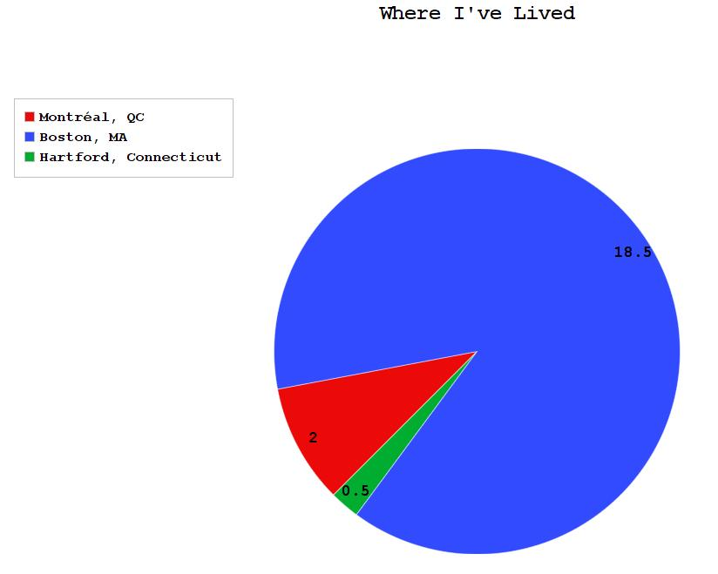
Places I Have Lived
Hartford, CT:
Born in 1996
Lived in Hartford for 6 mo.
Boston, MA:
Raised in Boston
Elementary School :
Josiah Quincy Elementary School in Chinatown
Middle School:
Josiah Quincy Upper School in Chinatown
High School:
Boston Latin School
Montreal, QC:
Currently studying at McGill University
Studying Computer Science and Economics

Slide 3
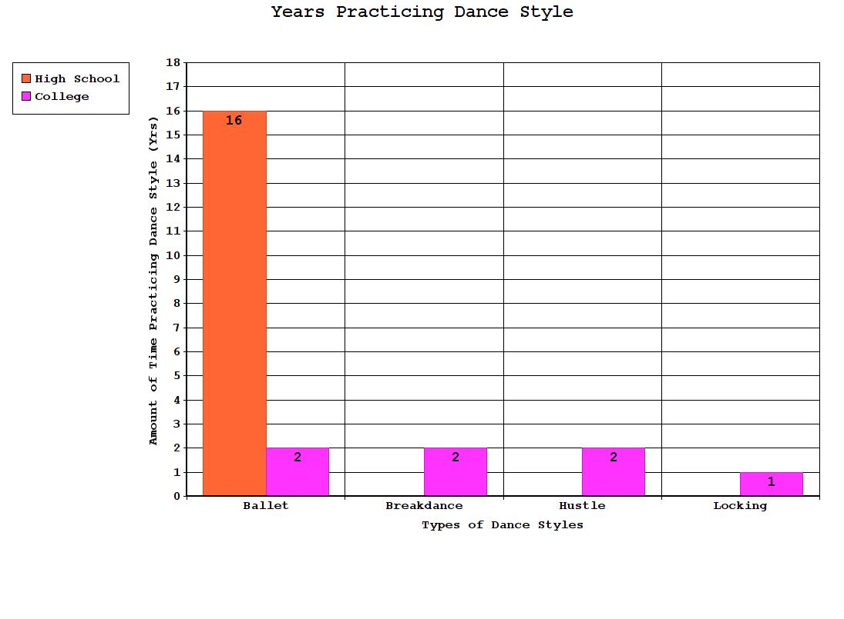
Ballet:
Started at 3 years old
Boston Ballet School
Graduated in 2015
Gap year in Pittsburgh
Studied at Pittsburgh Ballet Theatre (2016-2017)
Breakdance:
Started learning at McGill
Taught by peers
Entered jams
Currently learning windmills, flares, head spins, footwork, etc.
Hustle:
Started learning at McGill
Partnered dance
Locking:
Started learning at McGill
Funky style of dance
Experience in Different Dance Styles

Slide 4
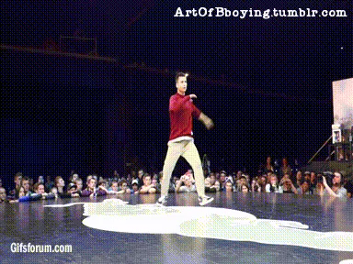
Thank You for Listening

